Slide 1
Web & Api Development
Praveen nair

Slide 2
Introduction to Django
Django is a Python web framework that enables rapid development of secure and maintainable websites.
Follows the model–template–views architectural pattern.
Created in the year 2003
It’s free and open source.
It is maintained by the Django Software Foundation (DSF), an independent organization established in the US.
Visit https://www.djangoproject.com/ for more information

Slide 3
Top Backend Technologies
Node.js - is an open-source, cross-platform JavaScript framework that is used to build server-side and networking applications.
Django - is an open-source framework based on Python. It is a web framework from the server’s side. Django follows the Model Template View (MTV) architecture.
Spring Boot - is an open-source web framework based on Java that allows developers to build production-grade and standalone applications.
ASP.NET - is an open source web framework, created by Microsoft, for building modern web apps and services that run on macOS, Linux, Windows, and Docker.
Laravel - is a PHP framework that provides a built-in user interface, flexibility, API support, creativity, and an extensive range of various libraries that help in the development process of secure web applications

Slide 4
The Course Prerequisites
Knowledge of Python Programming
Understanding of HTML, CSS and JavaScript
Basic idea of any database

Slide 5
Django Framework
Model – View – Template
(Data – Business Logic – Display Page)

Slide 6
Install Python and VS Code
Goto https://www.python.org/downloads/ and download pthon
While installling python select checkbox to add path
Goto https://code.visualstudio.com/download and download Visual Studio Code
Install and then open visual Studio code
Click extension icon on the left and then install python (from Microsoft)
Close visual studio

Slide 7
Setup Virtual Environment
Search and open powershell as administrator and run following command
Set-ExecutionPolicy RemoteSigned
then press A
Create a folder myproj on desktop
open visual studio code and then open folder myproj from desktop
Goto view menu > click terminal
In terminal type,
pip install virtualenv
python -m venv myenv
./myenv/scripts/activate (for windows users)
source ./myenv/bin/activate (for mac users)

Slide 8
Install django and create project
pip install django
pip list (verify that django has been installed)
Django-admin startproject myproj .
python manage.py startapp core
mkdir templates
python manage.py migrate (observe sqlite file on the left)

Slide 9
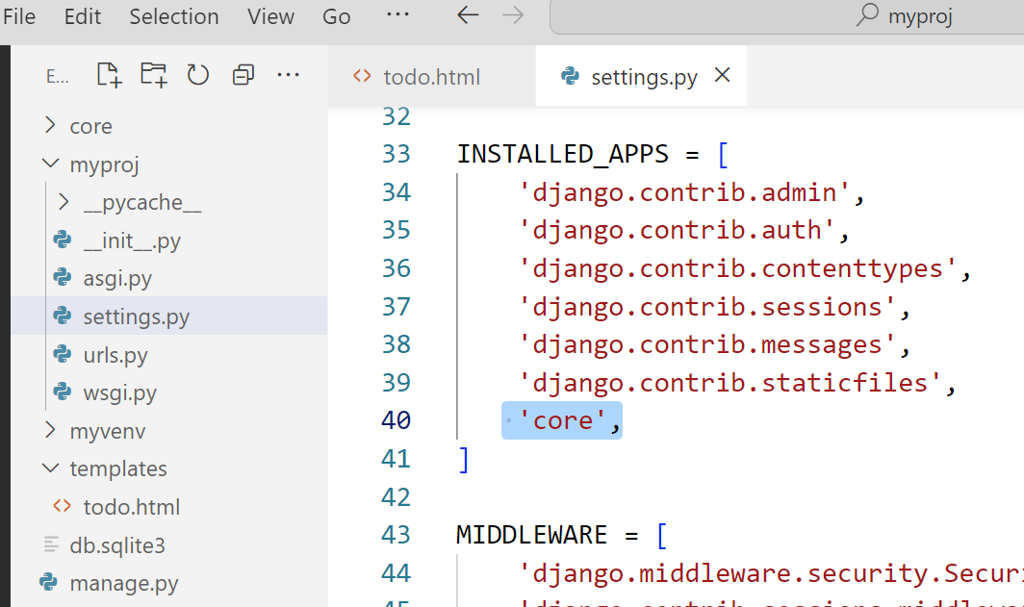
Configure core in settings.py

Slide 10
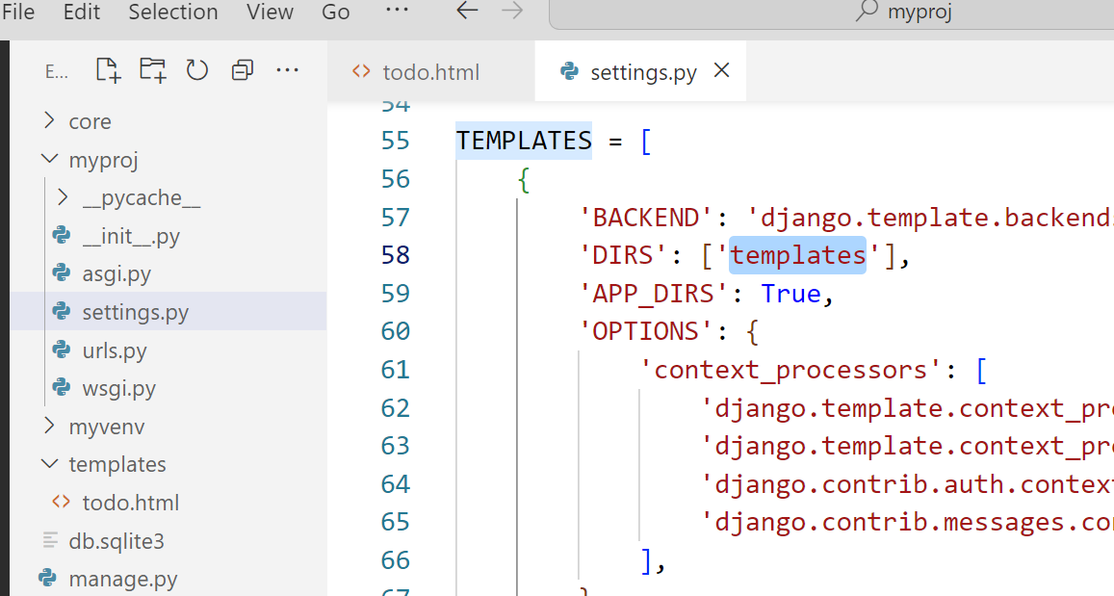
Configure templates in settings.py

Slide 11
Run server and view todo in browser
In terminal type > python manage.py runserver
open any browser and type following url to view todo app
http://127.0.0.1:8000/

Slide 12
Django base.html Example
A Django base.html is a master template that defines your website's common layout (like headers, navbars, and footers) using {% block %} tags so individual pages can inject unique content through inheritance ({% extends %}).
Django-admin startproject website1 .
mkdir templates
python manage.py migrate (observe sqlite file on the left)

Slide 13
Create base html page
Base html
{% block content %}
{% endblock %}
…………………………………….
Go to preferences > settings > emmet > include language > add item – Django-html : html

Slide 14
Create home,contact,about pages
{% extends 'base.html'%}
{% block content %}
html content here
{% endblock %}

Slide 15
Fast API
FastAPI is a modern, high-performance web framework used for building application programming interfaces (APIs) with Python.
It is built on top of standard Python type hints and leverages Starlette for web routing and Pydantic for data validation.
Because it natively supports asynchronous programming (async/await), it is incredibly fast—on par with NodeJS and Go

Slide 16
Install Fast API
mkdir fastapi-demo
cd fastapi-demo
python -m venv .venv
.venv\Scripts\activate
pip install "fastapi[standard]"

Slide 17
Your first API
from fastapi import FastAPI
from fastapi.responses import JSONResponse
app = FastAPI()
@app.get("/")
def home():
return JSONResponse(
status_code=200,
content={"message": "Hello World"}
)
Start it:
fastapi dev main.py (default port 8000)
fastapi dev main.py --port 9000
Then visit:
http://127.0.0.1:8000
You'll get:
{
"message": "Hello FastAPI"
}

Slide 18
requests module to access api
import requests
url = "http://127.0.0.1:8000/"
res = requests.get(url).json()
print(res)

Slide 19
Automatic Swagger documentation
One of FastAPI's best features is that you already have interactive API documentation.
Open:
http://127.0.0.1:8000/docs
There's also ReDoc at:
http://127.0.0.1:8000/redoc
Both are generated automatically from your API's OpenAPI schema.
ReDoc is one of the two auto-generated, interactive API documentation user interfaces provided right out of the box. While the default Swagger UI (/docs) is designed as an interactive playground for live testing, ReDoc is a polished, professional reference guide optimized for reading, publishing, and sharing your API structure with external teams or clients.

Slide 20
Path parameters
uppose you want:
GET /users/123
Write:
@app.get("/users/{user_id}")
def get_user(user_id: int):
return {
"user_id": user_id
}

Slide 21
Query parameters
For something like:
/products?limit=10&search=iphone
you can write:
@app.get("/products")
def get_products(
limit: int = 10,
search: str | None = None
):
return {
"limit": limit,
"search": search
}

Slide 22
POST requests with Pydantic
Pydantic is an open-source data validation and parsing library for Python that enforces type hints at runtime.
from pydantic import BaseModel
class Product(BaseModel):
name: str
price: float
in_stock: bool = True
@app.post("/products")
def create_product(product: Product):
print(product.name)
return {
"message": "Product created",
"product": product
}

Slide 23
Build a small CRUD API – Part 1
from fastapi import FastAPI, HTTPException
from pydantic import BaseModel
app = FastAPI()
class Product(BaseModel):
name: str
price: float
in_stock: bool = True

Slide 24
Build a small CRUD API – Part 2
products = {}
@app.get("/")
def home():
return {"message": "Product API"}
@app.get("/products")
def get_products():
return product

Slide 25
Build a small CRUD API – Part 3
@app.get("/products/{product_id}")
def get_product(product_id: int):
if product_id not in products:
raise HTTPException(
status_code=404,
detail="Product not found"
)
return products[product_id]

Slide 26
Build a small CRUD API – Part 4
@app.post("/products", status_code=201)
def create_product(product: Product):
product_id = len(products) + 1
products[product_id] = product
return {
"id": product_id,
"product": product
}

Slide 27
Build a small CRUD API – Part 5
@app.put("/products/{product_id}")
def update_product(
product_id: int,
product: Product
):
if product_id not in products:
raise HTTPException(
status_code=404,
detail="Product not found"
)
products[product_id] = product
return product

Slide 28
Build a small CRUD API – Part 6
@app.delete("/products/{product_id}")
def delete_product(product_id: int):
if product_id not in products:
raise HTTPException(
status_code=404,
detail="Product not found"
)
del products[product_id]
return {"message": "Product deleted"}

Slide 29
Build a small CRUD API – Summary
Method Endpoint Purpose
GET /products List products
GET /products/{id} Get one
POST /products Create
PUT /products/{id} Update
DELETE /products/{id} Delete

Slide 30
Understanding async
async def is especially useful when you're awaiting asynchronous I/O, such as:
async def get_users():
users = await database.fetch_users()
return users
You don't need to make every function async just because you're using FastAPI.

Slide 31
Accessing API
import requests
url = https://jsonplaceholder.typicode.com/users/
url = https://mern-backend-drab-rho.vercel.app/api/products/6925cb229ec5211c57699755
res = requests.get(url).json()
res = requests.delete(url)
data = {
"productName": "Product F",
"description": "This is description",
"price": 100,
"imgUrl": https://picsum.photos/id/10/300/300
}
res = requests.post(url, json=data)
Res = requests.patch(url,json=data)
for i in res: #res["products"]
print(i)
#print(i[name])

Slide 32
openweather API
Goto openweathermap.org > Api menu > current weather data > click subscribe > and create a free account to get api key
import requests
city="Bengaluru,IND“
api="3053eb0913958c6c35c9“
url = f"https://api.openweathermap.org/data/2.5/weather?q={city}&appid={api}"
res = requests.get(url).json()
tmp = res['main']['temp’]
tmp_c = round(tmp-273.15) #convert from kelvin to Celsius
print(f'Current temperatur in {city} is {tmp_c}°C')

Slide 33
Create todo model
Update models.py
from django.db import models
class todo(models.Model):
task=models.CharField(max_length=50)
Run following in terminal:
python manage.py makemigrations
python manage.py migrate

Slide 34
Add todo function in views.py
from core import models
def todo(request):
if request.method=="POST":
req=request.POST.get("task")
task = models.todo(task=req)
task.save()
mytodo = models.todo.objects.all()
data = {'todos':mytodo}
return render(request,"todo.html",data)

Slide 35
Add deleteTodo function in views.py
def deleteTodo(request):
if request.method=="GET":
todoId = int(request.GET.get("id"))
models.todo.objects.filter(id=todoId).delete()
return todo(request)

Slide 36
Create todo.html inside templates
<!DOCTYPE html>
<html lang="en">
<head><title>Document</title></head>
<body>
<h1>Todo Application</h1>
<form method=“POST">
{% csrf_token %}
<p><input type="text“ name=“task” /><button>Add</button></p>
</form>
{% for row in todos%}
<div>
{{row.task}} <a href="/deleteTodo/?id={{row.id}}">Delete</a>
</div>
{% endfor %}
</body>
</html>

Slide 37
Add path in urls.py
from django.contrib import admin
from django.urls import path,include
from core import views
urlpatterns = [
path('admin/', admin.site.urls),
path('',views.todo),
path('deleteTodo/',views.deleteTodo),
]

Slide 38
Testing
FastAPI provides TestClient, which works naturally with pytest.
For example:
from fastapi.testclient import TestClient
from main import app
client = TestClient(app)
def test_home():
response = client.get("/")
assert response.status_code == 200
assert response.json() == {
"message": "Product API"
}
Run with:
pip install pytest httpx
pytest

Slide 39
Thank You
- Praveen Nair

